Slide 1
INTRODUCTION TO COMPUTING
Michael D’Argenio – mjdargen@ncsu.edu
Electrical Engineering – SS 2019 – Duke TIP

Slide 2
WHAT IS A COMPUTER?

Slide 3
“A computer is a machine that can be instructed to carry out sequences of arithmetic or logical operations automatically.”

Slide 4
A computer is a machine that can:
Accept input
Execute a procedure
Produce output

Slide 5
Computer must have:
Input/Output or I/O
Processor
Memory (requirement for modern computers)

Slide 6
Programming
How we tell processors what to do.
Programming can either be
Mechanical
Hardware
Software

Slide 7
How computers differ from machines:
Machines amplify or extend our physical abilities while computers amplify and extend our mental abilities.
Machines are designed to perform a few specific tasks while computers can be programmed to perform many tasks.
There exists very simple computer models that provide the framework to perform any possible computation.

Slide 8
HISTORY OF COMPUTING

Slide 9
Crash Course History of Computing
https://youtu.be/O5nskjZ_GoI
https://youtu.be/LN0ucKNX0hc

Slide 10
HOW IS IT ELECTRICAL ENGINEERING?

Slide 11
LEVELS OF ABSTRACTION
Software
Programmable Logic
Hardware
Fundamental Theorem of Software Engineering:
"We can solve any problem by introducing an extra level of indirection.“ – Andrew Koenig

Slide 12
INTRO TO THE WORLD OF COMPUTING

Slide 13
The World of Computing
Computers are dumb.
They do exactly what we tell them to do, nothing more.
If something is wrong, 99.99999999% of the time:
It is because we told it to do the wrong thing OR
We told it to do the right thing in the wrong way.
Approach:
Build understanding from the bottom up.
Bits ➔ Gates ➔ Processor ➔ Instructions ➔ C Programming

Slide 14
Two Recurring Themes
Abstraction
Productivity enhancer – don’t need to worry about details.
Can drive a car without knowing how the internal combustion engine works… until something goes wrong!
Where is the spark plugs? What is a spark plug?
Important to understand the components and how they work together.
Hardware vs. Software
It’s not either/or – both are important components of a computer system.
Even if you specialize in one, you should understand capabilities and limitations of both.

Slide 15
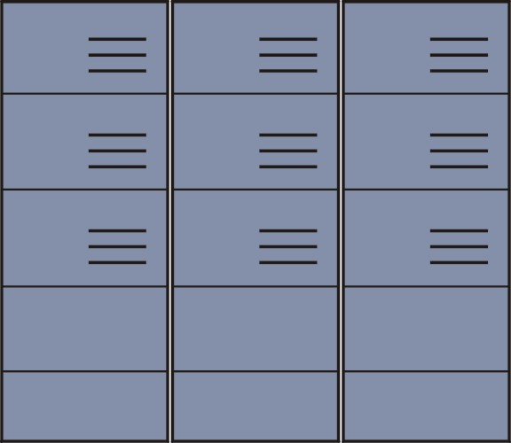
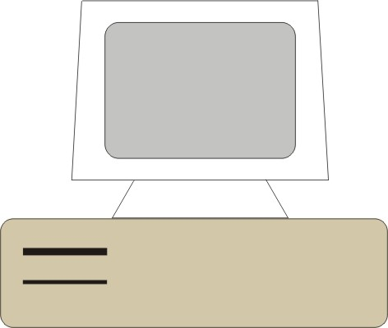

Big Idea #1: Universal Computing Device
All computers, given enough time and memory, are capable of computing exactly the same things.
=
=
Smart phone
Workstation
Supercomputer

Slide 16
Turing Machine
Mathematical model of a device that can perform any computation – Alan Turing (1937)
ability to read/write symbols on an infinite “tape”
state transitions, based on current state & input
Every computation can be performed by some Turing machine. (Turing’s thesis)
T_{add}
T_{mul}
a,b
a+b
a,b
ab
Turing machine that adds
Turing machine that multiplies
For more info about Turing machines, see
http://www.wikipedia.org/wiki/Turing_machine/
For more about Alan Turing, see
http://www.turing.org.uk/turing/

Slide 17
Universal Turing Machine
A machine that can implement all Turing machines -- this is also a Turing machine!
inputs: data, plus a description of computation
U is programmable – so is a computer!
instructions are part of the input data
a computer can emulate a Universal Turing Machine
A computer is a universal computing device.
T_{add}, T_{mul}
U
a,b,c
c(a+b)
Universal Turing Machine

Slide 18
From Theory to Practice
In theory, a computer can compute anything that’s possible to compute given enough memory and time.
In practice, solving problems involves computing under constraints.
time
weather forecast, next frame of animation, ...
cost
cell phone, automotive engine controller, ...
power
personal electronics, remote sensors, …

Slide 19
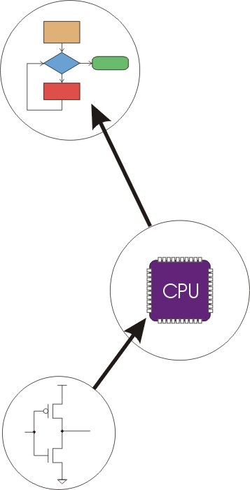
Big Idea #2: Transformation betw. Layers
Problems
Algorithms
Language
Instruction Set Architecture
Microarchitecture
Circuits
Devices

Slide 20
How to solve problems using a computer?
A systematic sequence of transformations between levels of abstraction.
Problem
Software Design:
choose algorithms and data structures
Algorithm
Programming:
use language to express design
Program
Compiling/Interpreting:
convert language to machine instructions
Instr Set
Architecture

Slide 21
Deeper and Deeper…
Instr Set
Architecture
Processor Design:
choose structures to implement ISA
Microarch
Logic/Circuit Design:
gates and low-level circuits to implement components
Circuits
Process Engineering & Fabrication:
develop and manufacture lowest-level components
Devices

Slide 22
Descriptions of Each Level
Problem Statement
stated using "natural language"
may be ambiguous, imprecise
Algorithm
step-by-step procedure, guaranteed to finish
definiteness, effective computability, finiteness
Program
express the algorithm using a computer language
high-level language, low-level language
Instruction Set Architecture (ISA)
specifies the set of instructions the computer can perform
data types, addressing mode

Slide 23
Descriptions of Each Level (cont.)
Microarchitecture
detailed organization of a processor implementation
different implementations of a single ISA
Logic Circuits
combine basic operations to realize microarchitecture
many different ways to implement a single function (e.g., addition)
Devices
properties of materials, manufacturability

Slide 24
Many Choices at Each Level
Solve a system of equations
Gaussian
elimination
Jacobi
iteration
Red-black SOR
Multigrid
FORTRAN
C
C++
Java
Tradeoffs:
cost
performance
power
(etc.)
PowerPC
Intel x86
Atmel AVR
Centrino
Pentium 4
Xeon
Ripple-carry adder
Carry-lookahead adder
CMOS
Bipolar
GaAs
Notes:
Sun and Java are trademarks of Sun Microsystems, Inc. Intel, Pentium, Centrino, and Xeon are trademarks of Intel Corporation. AMD and Athlon and trademarks of Advanced Micro Devices, Inc. Atmel and AVR are registered trademarks of Atmel Corporation. PowerPC is a trademark of International Business Machines Corporation.

